Slide 1

Pong Game
Slava, Kai, Andres

Slide 2
Functionality

Slide 3
Technology Used
Front-end: Javascript, HTML/CSS
Back-end: Node.js
P2P on a local area network

Slide 4
Functionality
Client server for a host and guest in-game
Web-application
The game will look for other players on the LAN
Game will have guest and host, information exchanged using API

Slide 5
Walkthrough

Slide 6
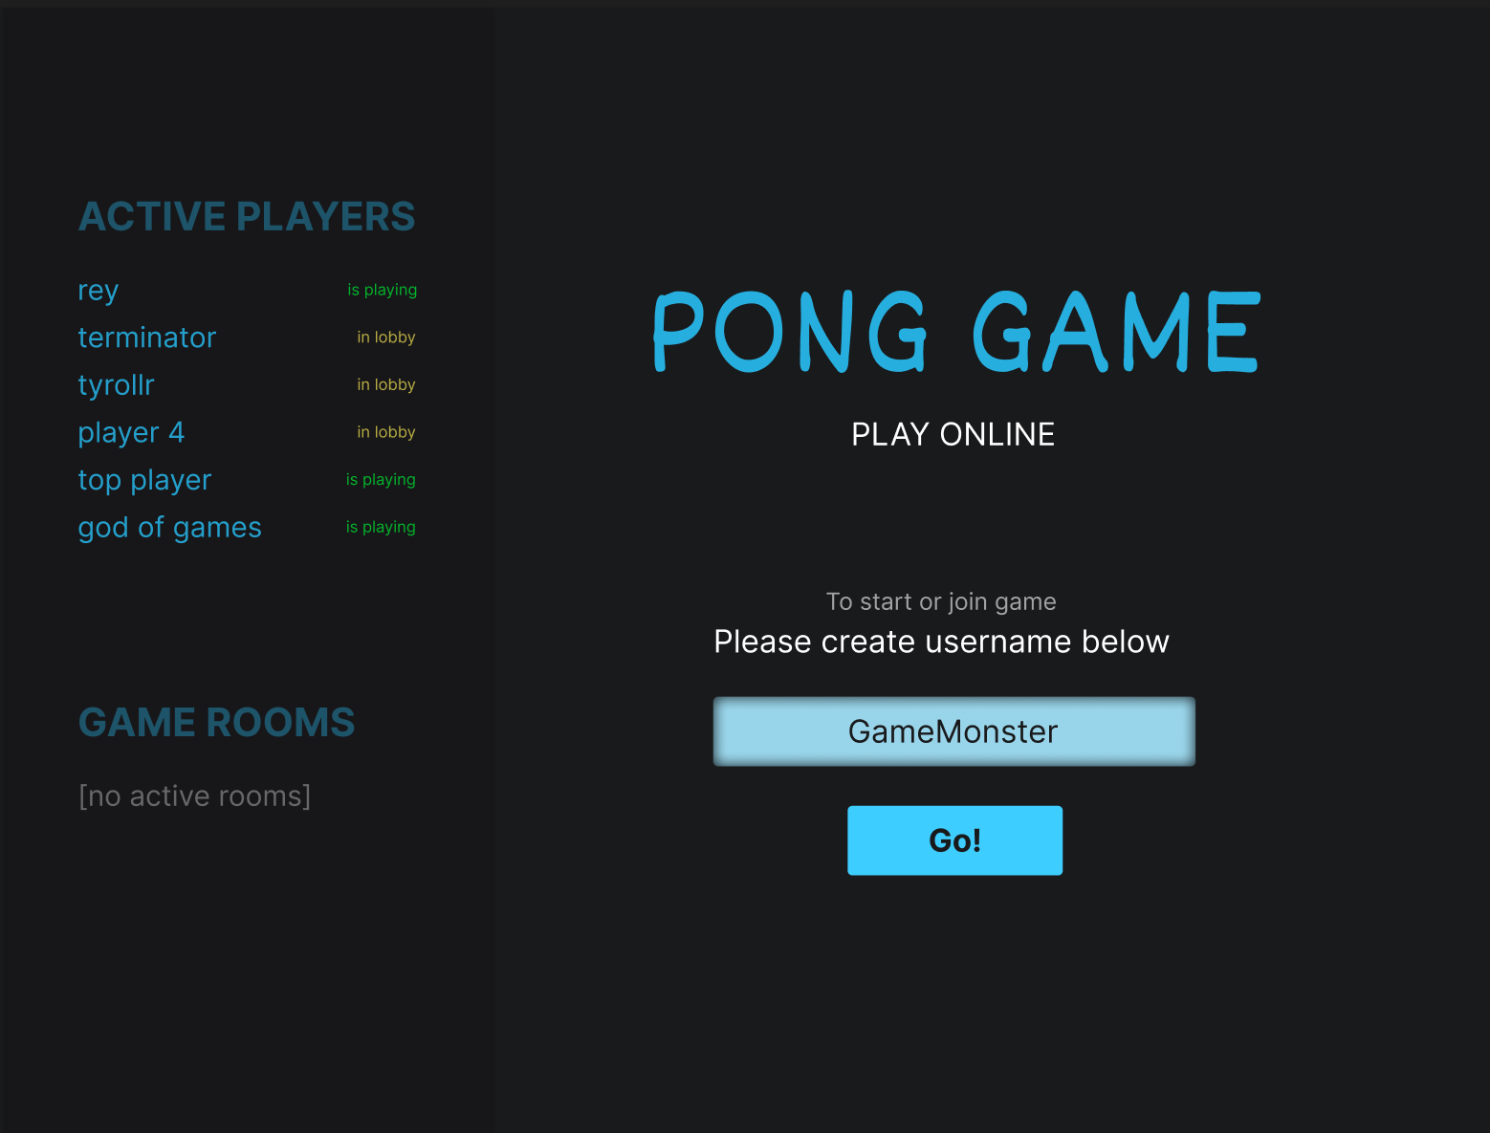
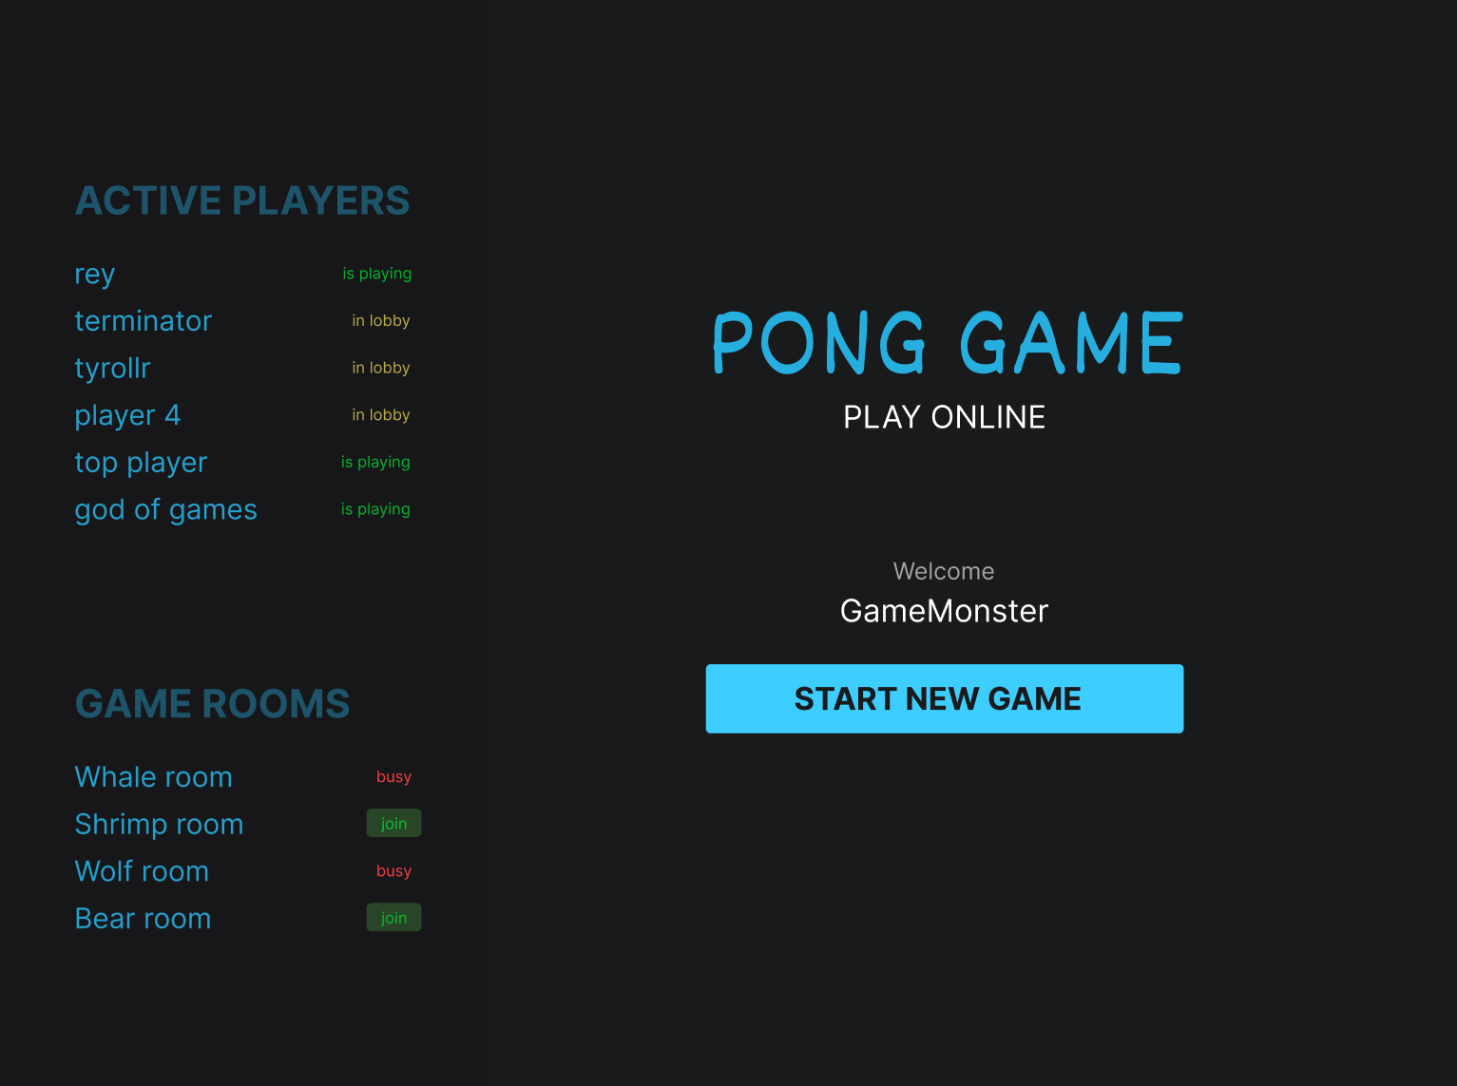
Starting game
Enter your username
Create or join a game room

Slide 7
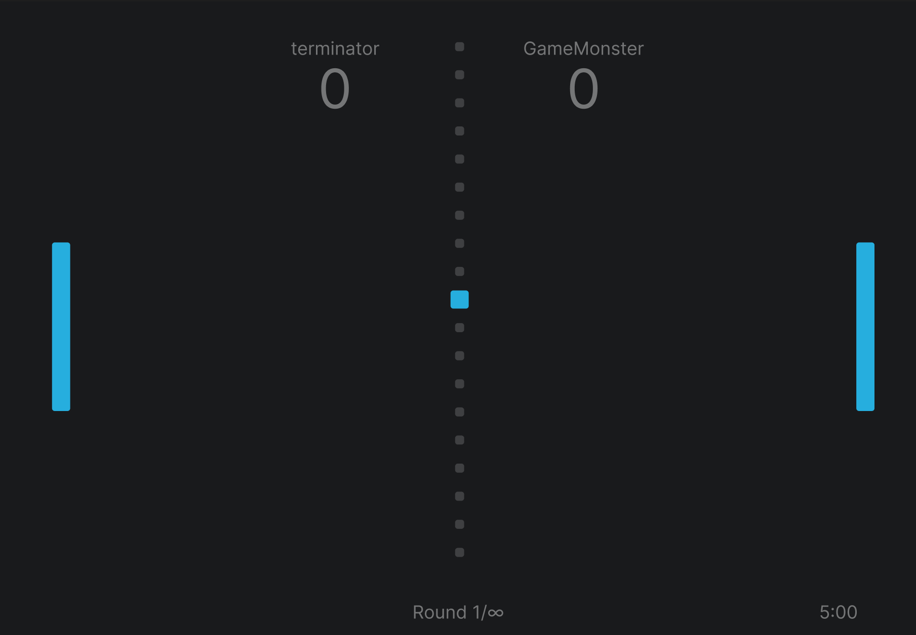
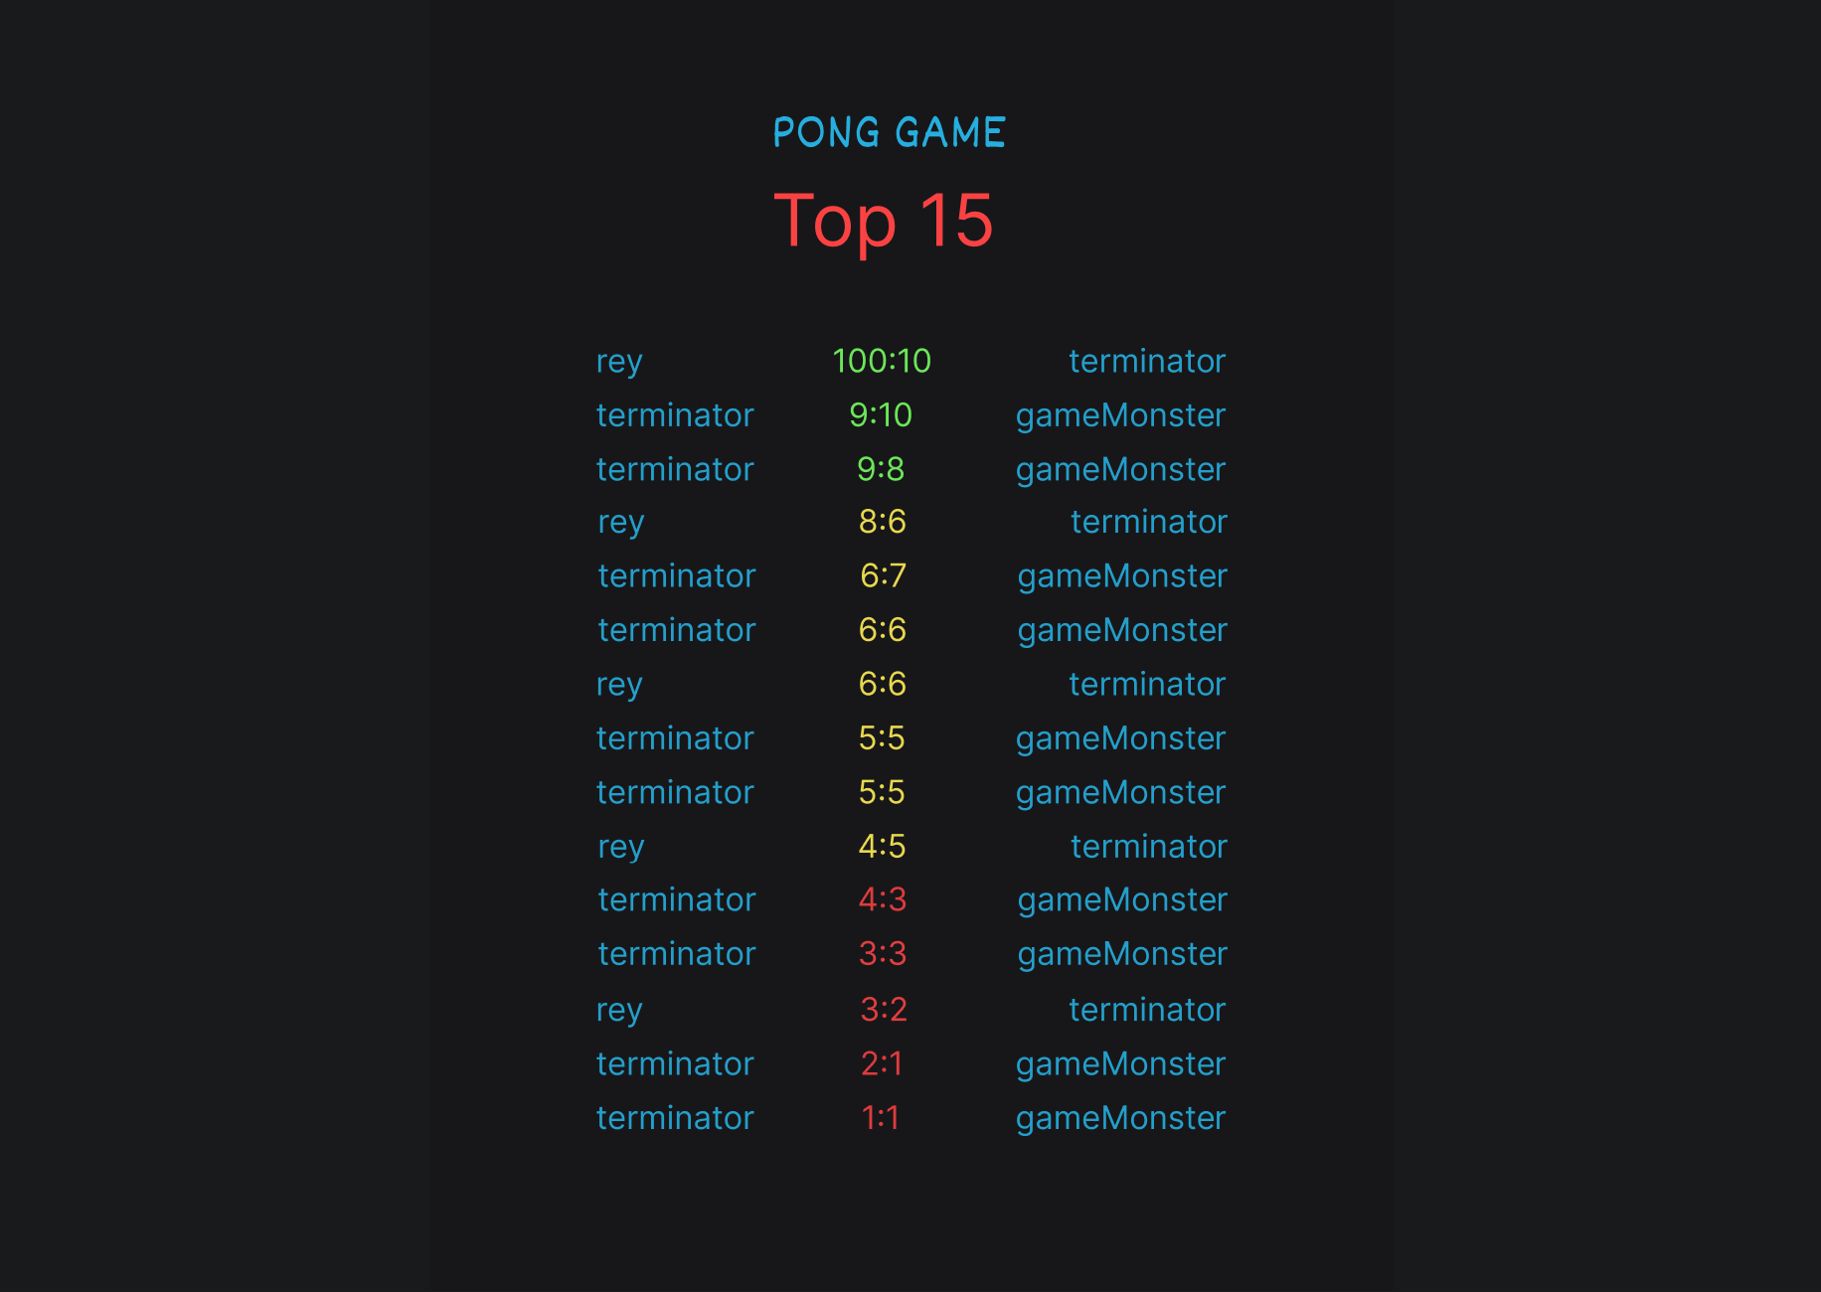
Starting game
Play the game by moving up and down the paddle
When game is finished(Either one player quits or reaches
Total of 5 rounds, the scoreboard displays, and you may
Return to the home screen

